Slide 1
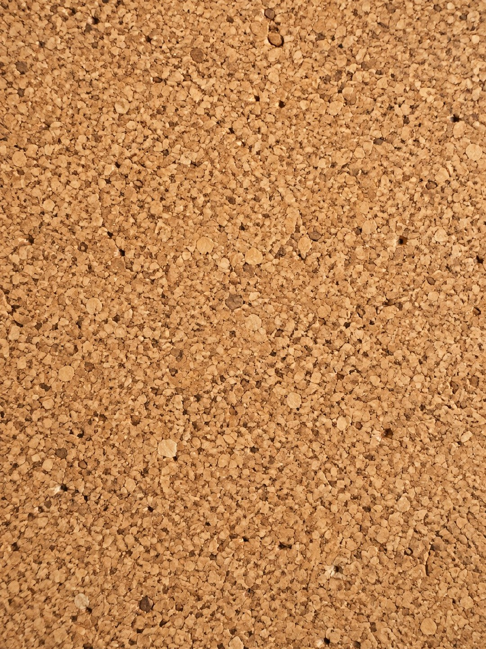

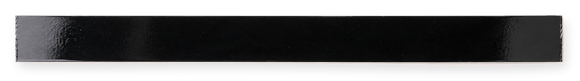
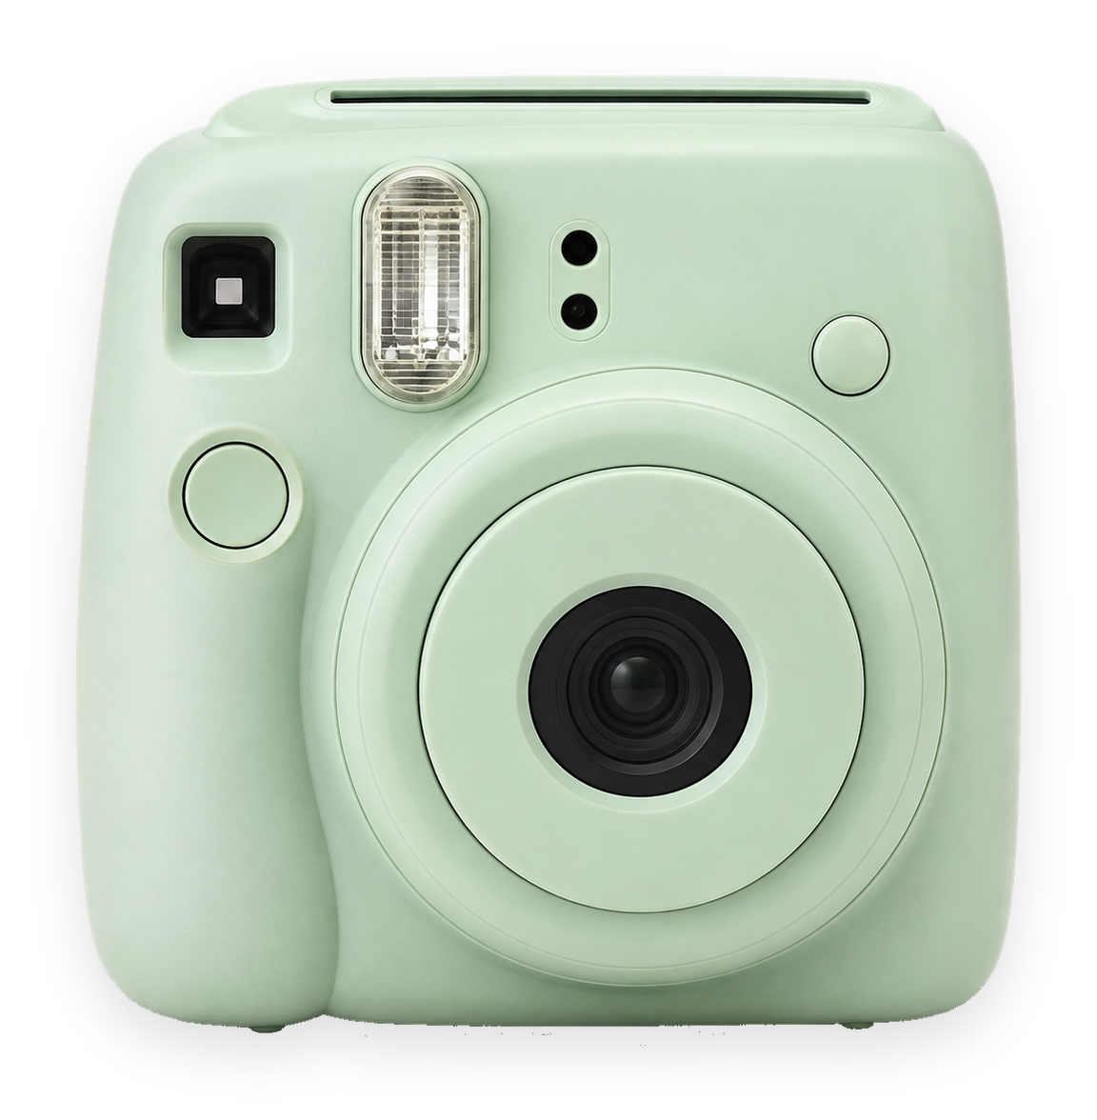

[WATCH THIS TRANSFORMATION]
Everything blue is a guide. Delete it before you download.
Notes:
Slide 1. Hook. Swap in a photo of the before for the camera lens. Edit the tape.

Slide 2


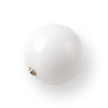
[you won't believe
the after]
[swipe for it]
Notes:
Slide 2. Second hook: Instagram often shows a carousel starting on slide 2, so this one works as a cover on its own. No photo needed. Edit both [bracket] lines.

Slide 3

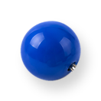

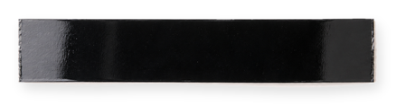
before
[THE BEFORE]
Notes:
Slide 3. Swap in a photo of the before. Edit the words.

Slide 4

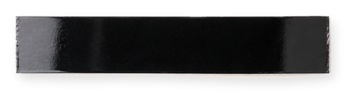
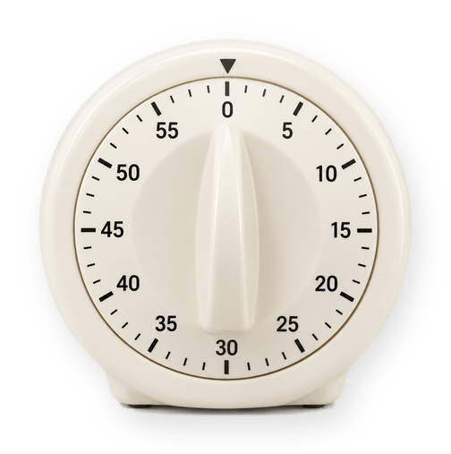
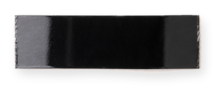
[CLEANING IT]
[20 MIN]
Notes:
Slide 4. Swap in a photo of the work in progress. Edit the time.

Slide 5



Notes:
Slide 5. Swap in a photo of the after.

Slide 6


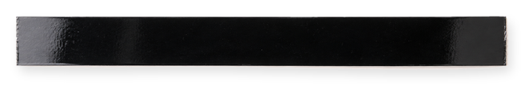
then
now
[SAME SPOT, 20 MIN LATER]
Notes:
Slide 6. The before and the after, side by side. Edit the captions.

Slide 7
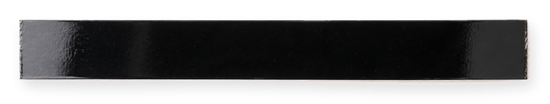


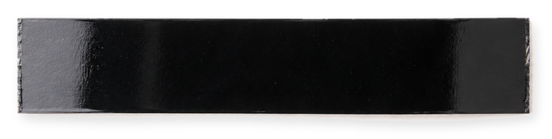


[WANT THE PRODUCT?]
"[KEYWORD]"
Notes:
Slide 7. Swap in a photo of your product. Type your keyword. Caption to start from (CTA in the first two sentences, 3 hashtags): Comment [KEYWORD] and I will send you [the link]. [One line of real context: who it helps or how you use it.] #[tag] #[tag] #[tag]

